Slide 1
Automating survey data validation using SAS macros
Eric Bush, DVM, MS
Centers for Epidemiology and Animal Health
Fort Collins, CO

Slide 2
Outline
Introduction
    NAHMS mission; team environment
    Data capture; data type; data flow.
Ad hoc approach to validation
    Components of validation code
    Issues with ad hoc approach
Automated approach to validation
    Critical data checks
    Defining variable use
    Validation reports
Notes:
Intro: Context (who we are; what we do; how we do it)

Slide 3
Hallmarks of a NAHMS national study
NAHMS Mission
NAHMS produces timely, factual information and knowledge about animal health.
National in scope
Voluntary
Collaborative
Confidential
Statistically valid
Multi-disciplinary staff
Veterinary epidemiologists
Livestock commodity specialists
Statisticians
Agriculture economist (trade)
Computer specialists
Data managers
Technical writer/editors

Slide 4
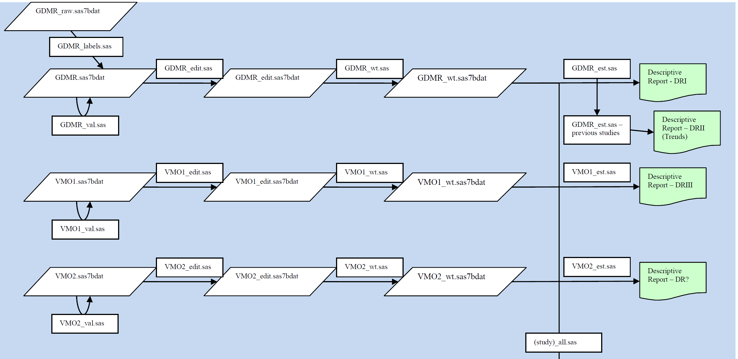
SAS data flow for NAHMS study

Slide 5
Generic variables in NAHMS questionnaire
Var name | Var type | Data type | Question
GroupID | Character | -- | n/a
IndivID | Character | -- | n/a
IC01 | Numeric | Discrete | Do you have [attribute]
IC02 | Numeric | Continuous | Total inventory
IC03 | Numeric | Continuous | How many of [item a]
IC04 | Numeric | Continuous | How many of [item b]
IC05 | Numeric | Continuous | How many of [item c]
IC06 | Numeric | Continuous | Sum of items a – c
IC07 | Numeric | Continuous | Age Out
IC08 | Numeric | Continuous | Age In
IC10 | Numeric | Discrete | Do you have [attribute]
IC11 | Numeric | either | Attribute follow-up
IC12 | Numeric | either | Attribute follow-up
COMPLETE | Numeric | Date | Interviewer completes
RESPONSE | Numeric | Discrete | Interviewer completes
Notes:
Data Capture: Face-to-face interviews; CATI; mail via NASS and/or State/Federal VMO’s.
Data Type: almost all numeric; mostly discrete or continuous

Slide 6
Ad hoc approach to validation
Write [questionnaire]_val SAS program to validate a specific dataset.
  Data and response code for respondents and non-respondents.
  Duplicate ID’s
  Proc freq macro for discrete responses
  Proc univariate for continuous responses
  Proc print of flagged observations from question-level edit checks.
Notes:
CON: Mixes analysis (proc freq and univariate) with edit checks. Different people writing code. E.g. skip check.

Slide 7
NAHMS data validation components
Duplicates
Missing ID
Totals
Skip patterns (two way check)
Valid values for discrete variables
Number of missing values
Other responses
Logic / consistency checks
Range checks
Notes:
Paired variables:
Subset variable less than whole variable
Proper order of temporal variables

Slide 8
Issues with ad hoc approach
Variability in programs
    Programming styles
    Level of documentation
Includes initial data analysis on unclean data.
Always get reams of output
Resource – time to write code, review output
    “Do more with less”
Completeness of checks
Check definitions
Notes:
Variability – programming styles; level of documentation; completeness of checks; check definitions (e.g. skip)
Goals for developing a new approach are to address these problems.

Slide 9
Concept for new approach
Institute a few questionnaire design standards
Focus on “critical” data validation checks
Build suite of macros for each critical check
Access macros via single validation program.
Notes:
Q design standards: numeric data; reduce internal skip patterns; project data structure; dataset naming conventions

Slide 10
Performing Criticial data validation checks
%ChkDupID
%ChkMissID
%ChkValue
%ChkBlock
%ChkSkip
%ChkSum
%ChkOrder
%ChkOther (for other response categories)

Slide 11
Concept for new approach
Institute a few questionnaire design standards
Focus on “critical” data validation checks
Build suite of macros for each critical check
Access macros via single validation program.
KEY: Validation macros are linked to a specific questionnaire dataset via spreadsheet of how variables are used.
Notes:
Q design standards: numeric data; reduce internal skip patterns; project data structure; dataset naming conventions

Slide 12
Generic variables in NAHMS questionnaire
Var name | Var type | Data type | Question
GroupID | Character | -- | n/a
IndivID | Character | -- | n/a
IC01 | Numeric | Discrete | Do you have [attribute]
IC02 | Numeric | Continuous | Total inventory
IC03 | Numeric | Continuous | How many of [item a]
IC04 | Numeric | Continuous | How many of [item b]
IC05 | Numeric | Continuous | How many of [item c]
IC06 | Numeric | Continuous | Sum of items a – c
IC07 | Numeric | Continuous | Age Out
IC08 | Numeric | Continuous | Age In
IC10 | Numeric | Discrete | Do you have [attribute]
IC11 | Numeric | either | Attribute follow-up
IC12 | Numeric | either | Attribute follow-up
COMPLETE | Numeric | Date | Interviewer completes
RESPONSE | Numeric | Discrete | Interviewer completes
Variable USE:
Identify observation
Notes:
Data Capture: Face-to-face interviews; CATI; mail via NASS and/or State/Federal VMO’s.
Data Type: almost all numeric; mostly discrete or continuous

Slide 13
Generic variables in NAHMS questionnaire
Var name | Var type | Data type | Question
GroupID | Character | -- | n/a
IndivID | Character | -- | n/a
IC01 | Numeric | Discrete | Do you have [attribute]
IC02 | Numeric | Continuous | Total inventory
IC03 | Numeric | Continuous | How many of [item a]
IC04 | Numeric | Continuous | How many of [item b]
IC05 | Numeric | Continuous | How many of [item c]
IC06 | Numeric | Continuous | Sum of items a – c
IC07 | Numeric | Continuous | Age Out
IC08 | Numeric | Continuous | Age In
IC10 | Numeric | Discrete | Do you have [attribute]
IC11 | Numeric | either | Attribute follow-up
IC12 | Numeric | either | Attribute follow-up
COMPLETE | Numeric | Date | Interviewer completes
RESPONSE | Numeric | Discrete | Interviewer completes
Variable USE:
Collect valid data values
Notes:
Valid Data values can be for data that is discrete or continuous.
For continuous data, different range definitions (fix, explain, confirm).

Slide 14
Generic variables in NAHMS questionnaire
Var name | Var type | Data type | Question
GroupID | Character | -- | n/a
IndivID | Character | -- | n/a
IC01 | Numeric | Discrete | Do you have [attribute]
IC02 | Numeric | Continuous | Total inventory
IC03 | Numeric | Continuous | How many of [item a]
IC04 | Numeric | Continuous | How many of [item b]
IC05 | Numeric | Continuous | How many of [item c]
IC06 | Numeric | Continuous | Sum of items a – c
IC07 | Numeric | Continuous | Age Out
IC08 | Numeric | Continuous | Age In
IC10 | Numeric | Discrete | Do you have [attribute]
IC11 | Numeric | either | Attribute follow-up
IC12 | Numeric | either | Attribute follow-up
COMPLETE | Numeric | Date | Interviewer completes
RESPONSE | Numeric | Discrete | Interviewer completes
Variable USE:
Part of a sum group
Notes:
Sum of variables may be defined constant, e.g. 100 or value of another variable.

Slide 15
Generic variables in NAHMS questionnaire
Var name | Var type | Data type | Question
GroupID | Character | -- | n/a
IndivID | Character | -- | n/a
IC01 | Numeric | Discrete | Do you have [attribute]
IC02 | Numeric | Continuous | Total inventory
IC03 | Numeric | Continuous | How many of [item a]
IC04 | Numeric | Continuous | How many of [item b]
IC05 | Numeric | Continuous | How many of [item c]
IC06 | Numeric | Continuous | Sum of items a – c
IC07 | Numeric | Continuous | Age Out
IC08 | Numeric | Continuous | Age In
IC10 | Numeric | Discrete | Do you have [attribute]
IC11 | Numeric | either | Attribute follow-up
IC12 | Numeric | either | Attribute follow-up
COMPLETE | Numeric | Date | Interviewer completes
RESPONSE | Numeric | Discrete | Interviewer completes
Variable USE:
Ordered observations
Notes:
Ordered observations: time interval; sub-set.

Slide 16
Generic variables in NAHMS questionnaire
Var name | Var type | Data type | Question
GroupID | Character | -- | n/a
IndivID | Character | -- | n/a
IC01 | Numeric | Discrete | Do you have [attribute]
IC02 | Numeric | Continuous | Total inventory
IC03 | Numeric | Continuous | How many of [item a]
IC04 | Numeric | Continuous | How many of [item b]
IC05 | Numeric | Continuous | How many of [item c]
IC06 | Numeric | Continuous | Sum of items a – c
IC07 | Numeric | Continuous | Age Out
IC08 | Numeric | Continuous | Age In
IC10 | Numeric | Discrete | Do you have [attribute]
IC11 | Numeric | either | Attribute follow-up
IC12 | Numeric | either | Attribute follow-up
COMPLETE | Numeric | Date | Interviewer completes
RESPONSE | Numeric | Discrete | Interviewer completes
Variable USE:
Part of a skip group

Slide 17
Business requirements
Numeric variables only (except ID)
Does not handle variable dependencies
Produce Negative report
Variable naming convention
Dataset naming convention
VarUse table can be used for any dataset version based on the questionnaire.
Notes:
Dataset naming convention: use ‘_’ to separate root dataset name from modifier; no other ‘_’ can be used in name.

Slide 18
VarUse_Create_Table
Validation_DSN
Validation_Datasets
ChkDup
ChkMissID
ChkValues
ChkSkip
Q
&Lib.&DSN
Dup
MissingID
%ChkValues*
VarList
Proc Format*
VarUse_
&Lib_&DSN
VarUse_&DSN
No
Any Obs
Yes
No
Any Obs
Yes
No
Errors
Yes
Cln_Chk_Rpt
&DSN
DupChk
MissIDChk
ValChk
Err_Sum_Rpt
&DSN
DupErrors
MissIDErrors
ErrorList
SAS dataset location
Temp directory
Project directory
Validation directory

Slide 19
VarUse_Create_Table
Validation_DSN
Validation_Datasets
ChkDup
ChkMissID
ChkValues
ChkSkip
Q
&Lib.&DSN
Dup
MissingID
%ChkValues*
VarList
Proc Format*
VarUse_
&Lib_&DSN
VarUse_&DSN
No
Any Obs
Yes
No
Any Obs
Yes
No
Errors
Yes
Cln_Chk_Rpt
&DSN
DupChk
MissIDChk
ValChk
Err_Sum_Rpt
&DSN
DupErrors
MissIDErrors
ErrorList
SAS dataset location
Temp directory
Project directory
Validation directory

Slide 20
VarUse_Create_Table
Validation_DSN
Validation_Datasets
Q
&Lib.&DSN
VarList
VarUse_
&Lib_&DSN
VarUse_&DSN
Cln_Chk_Rpt
&DSN
Err_Sum_Rpt
&DSN

Slide 21
VarUse.Create.Table.sas
/*******************************************************************************
PROGRAM: VarUse.Create_Table.sas
AUTHOR: Eric Bush
CREATED: November 16, 2009
PURPOSE: To create a dataset of variable names in preparation for performing critical data-validation checks on the dataset.
INPUT: SAS dataset
OUTPUT: Excel spreadsheet
*******************************************************************************/
/*-------------------*/
%LET LIB = GOAT; *<--- Put the directory name here;
%LET DSN = VMO; *<--- Put the dataset name here;
/*-------------------*/
** Create dataset with variable names and variable number (position) **;
PROC CONTENTS noprint
data=&LIB..&DSN
out=varlist(keep= name varnum);
run;
Notes:
User input: libname and dataset name.
Proc Contents: out= option to output; doesn’t suppress printing so have to use NOPRINT option.
Use period as special delimiter to end macro variable reference in the data= option.

Slide 22
VarUse.Create.Table.sas
** Re-order variables: i.e. put Variable number before name before exporting **;
data VarUse_&Lib._&DSN; retain Varnum Name; set Varlist;
Rename Name = VarName;
Valid_Values='';
Flag_Missing=.;
SkipO='';
TriggerOut='';
CompOperO='';
SkipI='';
TriggerIn='';
CompOperI='';
SumSeries='';
Total_Var=.;
VarLessThan='';
OTHtrig='';
run;
proc sort data=VarUse_&Lib._&DSN; by Varnum; run;
** Export dataset to Excel spreadsheet **;
PROC EXPORT DATA= VarUse_&Lib._&DSN
OUTFILE= "S:\Validation\VarUse tables\VarUse_&LIB._&DSN.(SHELL).xls"
DBMS=EXCEL REPLACE; NEWFILE=YES;
RUN;
Notes:
Store SAS dataset of contents output in validation directory. WHY??? Why not in WORK directory???
Retain statement: re-orders the variables so number is first then name.
Defines new variables that will be used in spreadsheet for indicating how each variable is ‘used’ (and therefore what macro’s).

Slide 23
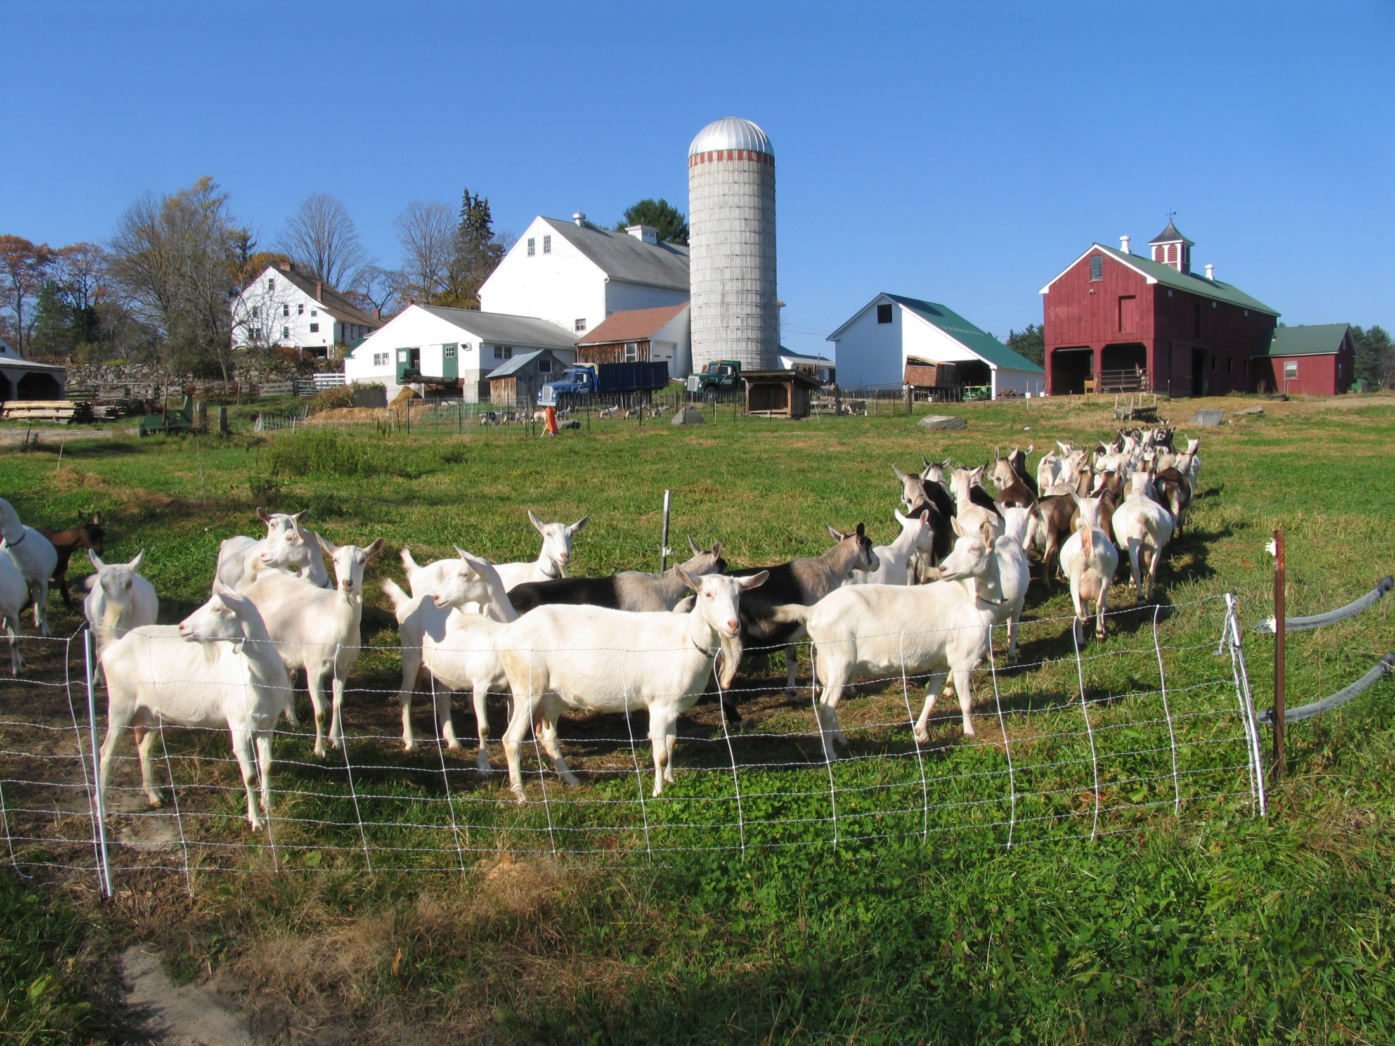
VarUse_ tables
Goat_VMO(Shell).XLS
Goat_VMO.XLS

Slide 24
Var Use table: Business Requirements
Valid Values check
    Define valid values as discrete list and/or continuous range
    List separators are space or comma
    Range defined by hyphen (-)
    Valid values must be numeric
    Assumes missing values ok unless Flag_Missing = 1

Slide 25
Q1. Did the herd possess some attribute? …………..……v001 □₁ Yes □₃ No
[If Q1 = NO then skip to Q4?]
Q2. How many had the attribute? ……………….…………v002 ________ head
Q3. At what age did the attribute occur? ………….………v003 ________ months
Q4. Did the herd possess another attribute? ……..………v004 □₁ Yes □₃ No

Slide 26
Screener question
Q1. Did the herd possess some attribute? …………..……v001 □₁ Yes □₃ No
[If Q1 = NO then skip to Q4?]
Q2. How many had the attribute? ……………….…………v002 ________ head
Q3. At what age did the attribute occur? ………….………v003 ________ months
Q4. Did the herd possess another attribute? ……..………v004 □₁ Yes □₃ No

Slide 27
Trigger
Q1. Did the herd possess some attribute? …………..……v001 □₁ Yes □₃ No
[If Q1 = NO then skip to Q4?]
Q2. How many had the attribute? ……………….…………v002 ________ head
Q3. At what age did the attribute occur? ………….………v003 ________ months
Q4. Did the herd possess another attribute? ……..………v004 □₁ Yes □₃ No

Slide 28
Skip group
Q1. Did the herd possess some attribute? …………..……v001 □₁ Yes □₃ No
[If Q1 = NO then skip to Q4?]
Q2. How many had the attribute? ……………….…………v002 ________ head
Q3. At what age did the attribute occur? ………….………v003 ________ months
Q4. Did the herd possess another attribute? ……..………v004 □₁ Yes □₃ No

Slide 29
Var Use table: Business Requirements
Skip pattern check
    Assign common label to variables in a skip group
    Variables do not have to be consecutive
    A skip group can have 1 or more screener variables
    Trigger condition(s) must be a numeric value
    Operators for multiple trigger conditions = AND, OR
    Can define one nested skip group
    Nested skip can share screener variables but not skip group variables.
Notes:
Next enchancement: allow trigger conditions that are ranges (same functionality as valid value column).

Slide 30
Var Use table: Business Requirements
Sum group check
    Assign common label to variables in a sum group
    Variables do not have to be consecutive
    Sum group can total to a constant or value of a variable
        Set Total_Var column for any sum group variable = k
        Indicate variable with total by setting Total_Var column = 1

Slide 31
Var Use table: Business Requirements
Ordered variable check
    Indicate in “VarLessThan” column the time-precedent variable or the parent variable.
    Must be valid variable name in SAS dataset
    Can be used to check that two variables are equal.
Notes:
Time-precedent variable: the variable observation comes before the variable listed in the “VarLessThan” column.
Parent variable: e.g. the total variable for a sum group; or other subset part of a whole.

Slide 32
VarUse_Create_Table
Validation_DSN
Validation_Datasets
Q
&Lib.&DSN
VarList
VarUse_
&Lib_&DSN
VarUse_&DSN
Cln_Chk_Rpt
&DSN
Err_Sum_Rpt
&DSN

Slide 33
Validation.template.sas
/******************************************************************************
PROGRAM: Validation.template.sas
AUTHOR: Eric Bush
CREATED: November 17, 2009
PURPOSE:
INPUT: User inputs libname, dataset name, name of ID variable, and the name of the survey (for title).
OUTPUT: printed output if there are any critical validation errors
******************************************************************************/
/*-------------------------------------------------------------------------*/
%LET LIB = Work; *<--- Put the directory name ("Library");
%LET DSN = ; *<--- Put the dataset name here in CAPS ;
%LET IDVAR = ; *<--- Put name of ID variable here ;
%LET SVYN = ; *<--- Put name of the survey here ;
/*-------------------------------------------------------------------------*/

Slide 34
Validation.template.sas
/******************************************************************************
PROGRAM: Validation.template.sas
AUTHOR: Eric Bush
CREATED: November 17, 2009
PURPOSE:
INPUT: User inputs libname, dataset name, name of ID variable, and the name of the survey (for title).
OUTPUT: printed output if there are any critical validation errors
******************************************************************************/
/*-------------------------------------------------------------------------*/
%LET LIB = GOAT; *<--- Put the directory name ("Library");
%LET DSN = VMO; *<--- Put the dataset name here;
%LET IDVAR = FarmID; *<--- Put name of ID variable here ;
%LET SVYN = NAHMS Goat 2009 study ; *<--- Put name of the survey here;
/*-------------------------------------------------------------------------*/

Slide 35
Validation.template.sas (cont)
*** Create datasets for conducting critical data validation checks ***;
***------------------------------------------------------------------***;
/*----------------------------------------------------------------------------*
|The "ValData" program creates the following datasets: |
| > Import VarUse table from Excel into a temporary SAS dataset |
| > Modifies var attributes of VarUse dataset and saves in project directory |
| > Creates Error Check dataset in project directory for report of neg checks| | > Creates summary dataset of Critical Validation errors for summary report |
*----------------------------------------------------------------------------*/
title1 " &SVYN ";
filename ValData 'S:\Validation\Macros\Validation.datasets.sas';
%inc ValData;
run;

Slide 36
Validation.datasets.sas
/************************************************************************************************************
PROGRAM: Validation.datasets.sas
AUTHOR: Eric Bush
CREATED: December 7, 2009
************************************************************************************************************/
*** DATASET 1 ***;
** Import Completed VarUse table from Excel into SAS dataset **;
data _Null_; call symputx('DSword', "%scan(&DSN,1,_.)"); run;
PROC IMPORT OUT= WORK.VarUse_&DSN
DATAFILE= "S:\Validation\VarUse tables\VarUse_&LIB._&DSword..xls"
DBMS=EXCEL REPLACE;
GETNAMES=YES; MIXED=YES; SCANTEXT=YES; USEDATE=YES; SCANTIME=YES;
RUN;
** VarUse dataset copied to project library **;
Data &LIB..VarUse_&DSN (Drop=TriggerOut TriggerIn); set VarUse_&DSN;
TriggerO= put(left(trim(TriggerOut)), $15.);
if compress(TriggerO)='.' then TriggerO='';
TriggerI= put(left(trim(TriggerIn)), $15.);
if compress(TriggerI)='.' then TriggerI='';
TotalVar=input(Total_Var, 3.);
OtherTrig= put(left(trim(OTHtrig)), $15.);
run;

Slide 37
Validation.datasets.sas
/************************************************************************************************************
PROGRAM: Validation.datasets.sas
AUTHOR: Eric Bush
CREATED: December 7, 2009
************************************************************************************************************/
*** DATASET 1 ***;
** Import Completed VarUse table from Excel into SAS dataset **;
data _Null_; call symputx('DSword', "%scan(&DSN,1,_.)"); run;
PROC IMPORT OUT= WORK.VarUse_&DSN
DATAFILE= "S:\Validation\VarUse tables\VarUse_&LIB._&DSword..xls"
DBMS=EXCEL REPLACE;
GETNAMES=YES; MIXED=YES; SCANTEXT=YES; USEDATE=YES; SCANTIME=YES;
RUN;
** VarUse dataset copied to project library **;
Data &LIB..VarUse_&DSN (Drop=TriggerOut TriggerIn); set VarUse_&DSN;
TriggerO= put(left(trim(TriggerOut)), $15.);
if compress(TriggerO)='.' then TriggerO='';
TriggerI= put(left(trim(TriggerIn)), $15.);
if compress(TriggerI)='.' then TriggerI='';
TotalVar=input(Total_Var, 3.);
OtherTrig= put(left(trim(OTHtrig)), $15.);
run;
&Dsword instead of &DSN:
Allows for use of same VarUse table for all versions of the dataset.
  DSN_raw
  DSN_edit
  DSN_wt

Slide 38
Validation.datasets.sas (cont)
*** DATASET 2 ***;
** Define dataset for accumulating data error checks with negative findings **;
%LET ECR = &LIB..Error_Check_Report_&DSN;
Data &ECR; length ChkID $ 9 ChkType $ 30 Comment $ 50;
ChkID = " ";
ChkType = ' ';
Comment = "Error Check Report for &LIB..&DSN";
run;

Slide 39
Validation.datasets.sas (cont)
*** DATASET 3 ***;
** Define Data Error dataset for summary of data errors by &IDVAR **;
PROC SQL NOPRINT;
SELECT TYPE INTO :IDTYPE
FROM DICTIONARY.COLUMNS
WHERE LIBNAME=upcase("&LIB") AND MEMNAME=upcase("&DSN") AND NAME="&IDVAR";
QUIT; RUN;
%macro IDEQMISS;
%IF &IDTYPE = num %THEN %DO;
IF &IDVAR=.;
%END;
%ELSE %IF &IDTYPE = char %THEN %DO;
IF &IDVAR='';
%END;
%mend IDEQMISS;
%LET CVER = Error_Sum_Report_&DSN;
Data &CVER; retain &IDVAR; length Check1-Check8 $ 14 Comment $ 50;
%IDEQMISS
Comment = "Critical Validation Error Report for &LIB..&DSN";
Label Check1 = 'Check 1‘ Check2 = 'Check 2'
Check3 = 'Check 3‘ Check4 = 'Check 4'
Check5 = 'Check 5‘ Check6 = 'Check 6'
Check7 = 'Check 7' Check8 = 'Check 8' ;
run;

Slide 40
VarUse_Create_Table
Validation_DSN
Validation_Datasets
ChkDup
ChkMissID
ChkValues
ChkSkip
Q
&Lib.&DSN
Dup
MissingID
%ChkValues*
VarList
Proc Format*
VarUse_
&Lib_&DSN
VarUse_&DSN
No
Any Obs
Yes
No
Any Obs
Yes
No
Errors
Yes
Cln_Chk_Rpt
&DSN
DupChk
MissIDChk
ValChk
Err_Sum_Rpt
&DSN
DupErrors
MissIDErrors
ErrorList
SAS dataset location
Temp directory
Project directory
Validation directory

Slide 41
Validation.template.sas (cont)
*** Call macros that conduct critical data validation checks ***;
***------------------------------------------------------------***;
** Check 1 - List duplicate ID's **;
filename ChkDupID 'S:\Validation\Macros\ChkDupID.macro.sas';
%inc ChkDupID; %ChkDupID(LIB=&LIB, DSN=&DSN, IDVAR=&IDVAR)
run;
** Check 2 - List missing ID's **;
filename CkMissID 'S:\Validation\Macros\ChkMissID.macro.sas';
%inc CkMissID; %ChkMissID(LIB=&LIB, DSN=&DSN, IDVAR=&IDVAR)
run;
** Check 3 - Check that variables have valid responses **;
filename CkValues 'S:\Validation\Macros\ChkValues.macro.sas';
%inc CkValues; %ChkValues(LIB=&LIB, DSN=&DSN, IDVAR=&IDVAR)
run;
** Check 4 - Check variable blocks with inconsistent responses **;
filename ChkBlock 'S:\Validation\Macros\ChkBlock.macro.sas';
%inc ChkBlock; %ChkBlock(LIB=&LIB, DSN=&DSN, IDVAR=&IDVAR)
run;
** Check 5 - Check for bad skip patterns **;
filename ChkSkip 'S:\Validation\Macros\ChkSkip.macro.sas';
%inc ChkSkip; %ChkSkip(LIB=&LIB, DSN=&DSN, IDVAR=&IDVAR)
run;

Slide 42
Validation.template.sas (cont)
** Print reports: Negative error checks; Critical validation error summary **;
**--------------------------------------------------------------------------**;
** For list of valid parameters used to check variables - run the following line of code **;
proc format fmtlib; run;
** Error Check Report for &LIB..&DSN **;
proc sort data=&ECR; by ChkID;
proc print data=&ECR n;
where ChkID ne '';
id ChkID; by ChkID;
title2 "Error Check Report for &LIB..&DSN";
footnote1 "Created from SAS session on &sysday., &Sysdate9 at &systime ";
run;

Slide 43
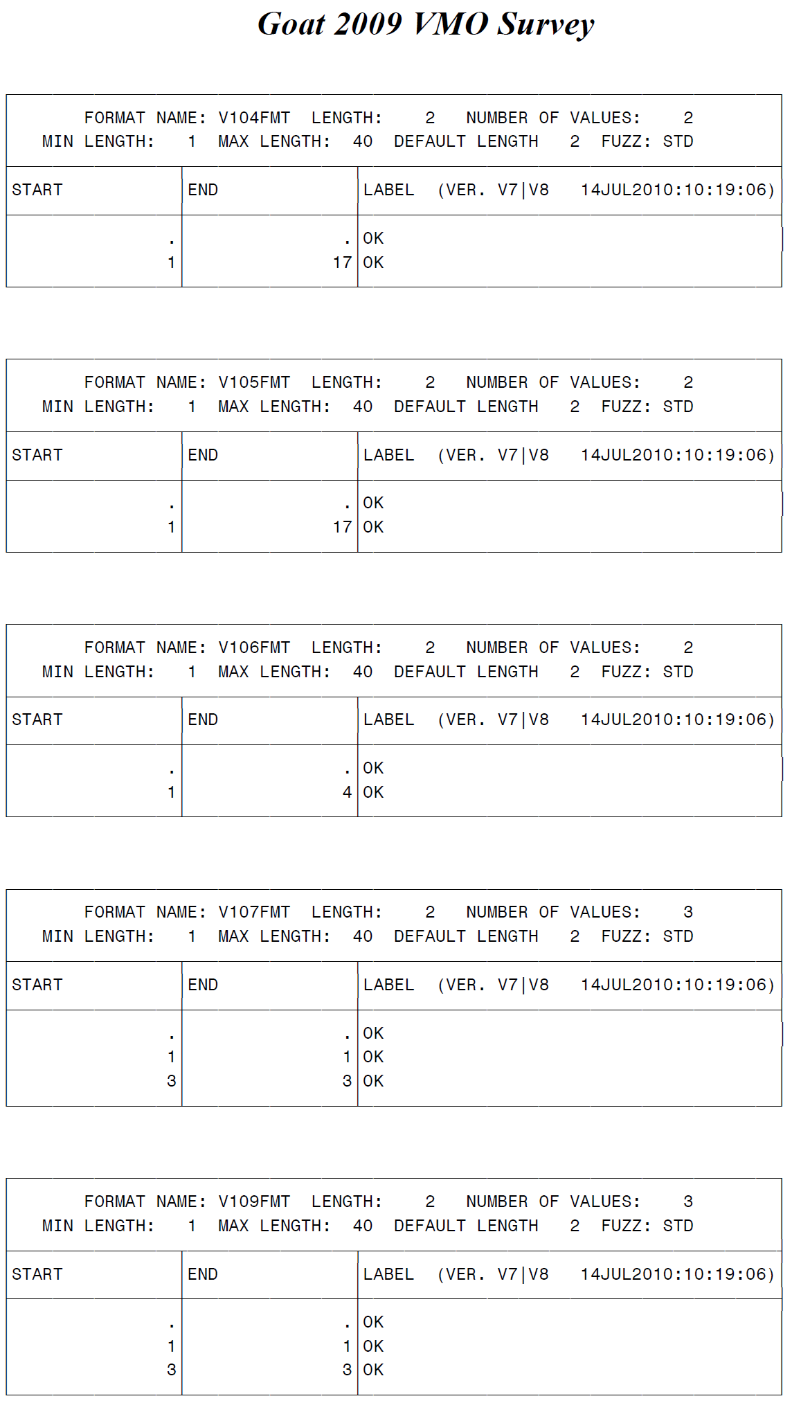
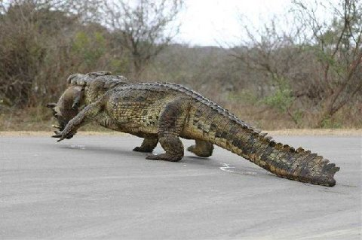
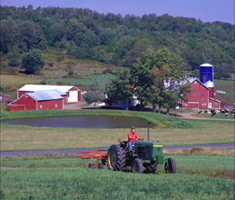
Format library showing user-defined formats

Slide 44
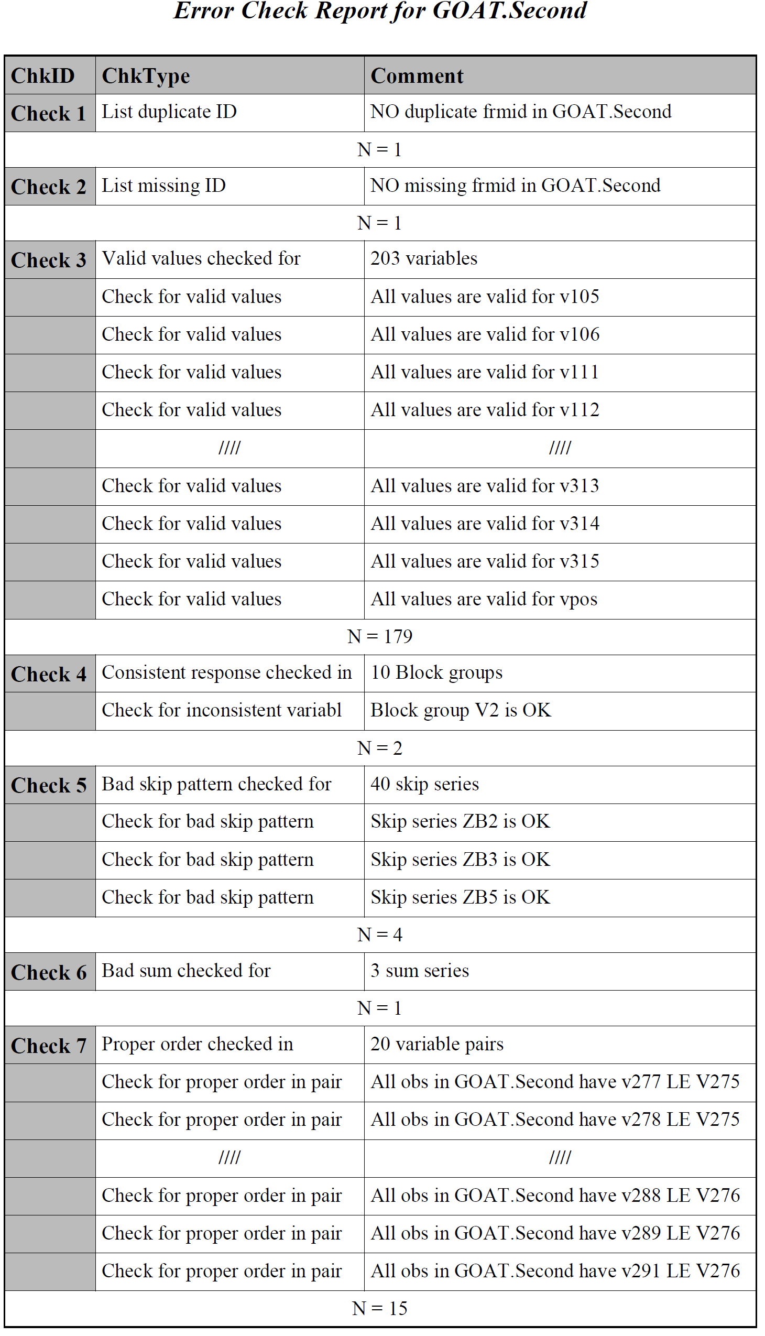
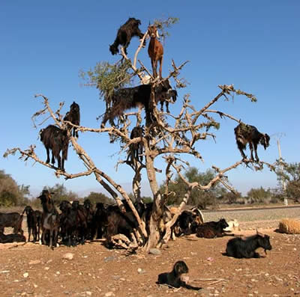
Error Summary report

Slide 45
Validation.template.sas (cont)
** Critical Validation Error Report for &LIB..&DSN **;
PROC freq data=&CVER noprint ;
tables &IDVAR * Check1 * Check3 * Check4 * Check5 * Check6 * Check7 * Check8 / list out=CVER_&DSN;
** NOTE: No reason to include Chk 2 since id is missing;
proc print data=CVER_&DSN;
id &IDVAR; var count Check: ;
title2 "Critical Validation Error Report for &LIB..&DSN" ;
footnote1 "Created from SAS session on &sysday., &Sysdate9 at &systime ";
run;

Slide 46
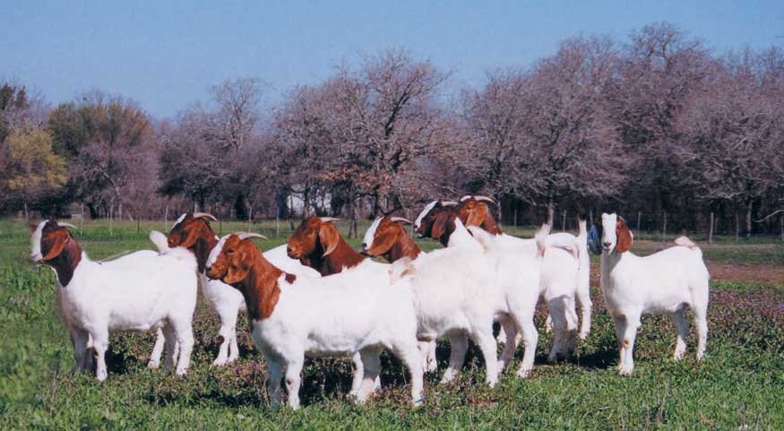
Critical Validation Error Summary report

Slide 47
Conclusion
Work in progress
Used on two questionnaires so far
Change is hard
Next steps: enchancements; debugging.

Slide 48
References
SAS Macro Language 1: Essentials Course Notes; 2009.
Cody, Ron. Cody's Data Cleaning Techniques Using SAS Software. Cary, NC: SAS Institute Inc.; 1999.
Carpenter, Art. Carpenter's Complete Guide to the SAS Macro Language. Second ed. Cary, NC : SAS Institute Inc.; 2004.

Slide 49
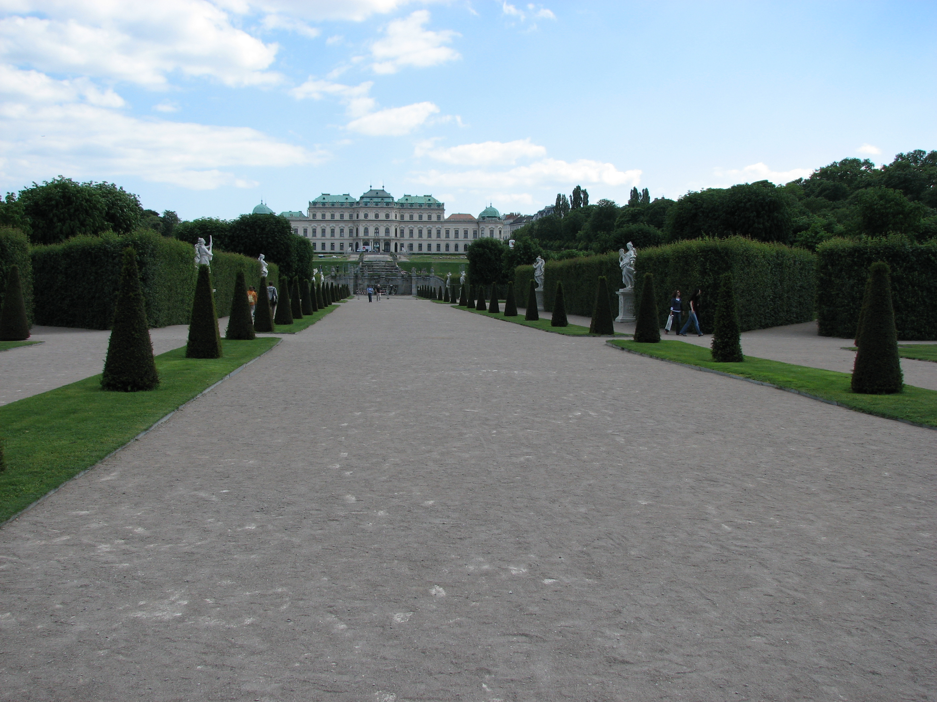
Thank you for
your attention.
Any Questions?

